Slide 1



Slide 2
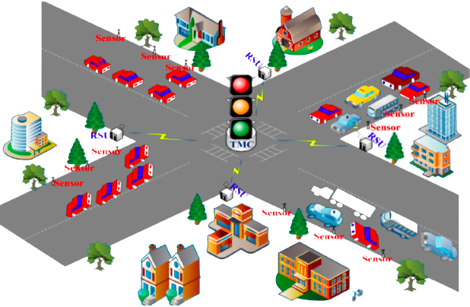
TRAFFIC CONTROL SYSTEM

Slide 3

Tejashwa Agarwal 20BAI1009
Vinisha Kingrani 20BPS1009
Ishika Agarwal 20BPS1084
Ritik Tiwari 20BPS1087
Kondhare Mugdha 20BPS1095

Slide 4

BRAINSTORMING SESSION

Slide 5
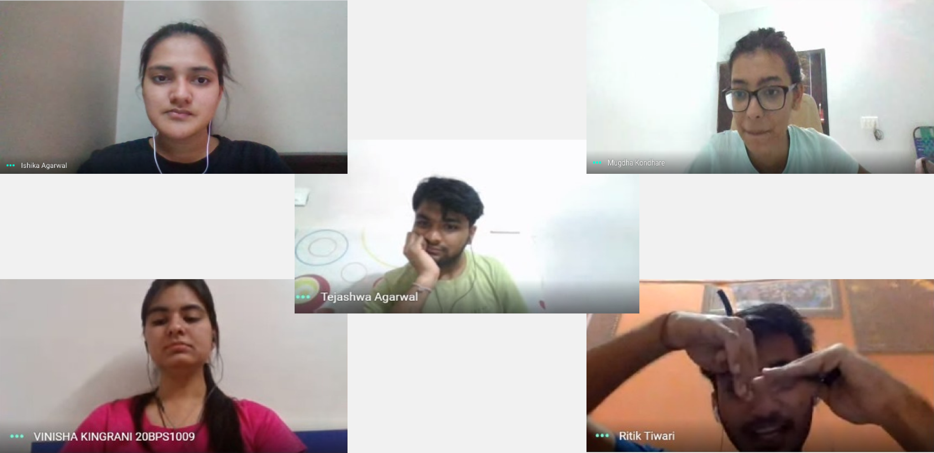


Slide 6

I
S
S
U
E
S
Increasing common air pollutants: NO_{x}, VOCs, CO, SO₂, PM2.5 contribute to global warming.
9/10 people breathe air with excess CO₂
Improper management of waste materials
Dependency of humans on natural resources
Over-exploitation of non renewable sources of energy
Oil & natural gas will get exhausted in another 50-60 years
Need for better technology for utilising maximum potential of solar & wind energy

Slide 7

Weather tracking system
Rotating solar panel
Synthesizing biofilms and bricks from fruit peels and organic waste
CFC filters
Alternative electrolytes in batteries
Traffic control system to reduce engine idling in jams

Slide 8

PROBLEMS IDENTIFIED
Impatient vehicle owners leave their engines idling leading to colossal fuel wastage and health hazards due to exhaust fumes.
Wasting fuel leads to air pollution due to the toxic fumes from the car exhaust.
Need for proper traffic management at such busy sites to help conserve precious petroleum imports and preserve our environment.
Emergency vehicles like ambulance and fire truck need to be given way quickly.

Slide 9

BACKGROUND WORK DONE
Lebanese University proposed a system to evaluate the traffic density using IR sensors and accomplishes dynamic timing slots with different levels.
MECHANISM: PIC microcontroller
MAIN AIM: To control traffic light using an embedded system to monitor and control vehicular traffic flow at road intersection
Technical University of Sofia suggested smart traffic control system which consist a combination of two independent systems. The combination of these two systems can easily control the traffic and help emergency vehicles to reach their destinations on time.
MECHANISM: Combination of two independent systems
First system uses RFID, smart semaphores
Second system uses stroboscope lights and sensors
MAIN AIM: To control the traffic and help emergency vehicles to reach their destinations on time

Slide 10
FRAMING THE OBJECTIVE TO FIND POSSIBLE SOLUTION
TO THE IDENTIFIED PROBLEM
OBJECTIVE:
To adjust the preset system of traffic signals based on the density of traffic on the street.
To detect emergency vehicles stuck in traffic and provide a way.
MECHANISM:
Image processing will analyse the density of traffic in the streets and the duration of the traffic signals are adjusted accordingly.
The system will automatically detect the emergency vehicle in the video after converting into images with the help of image pre-processing activities.

Slide 11


